Slide 1

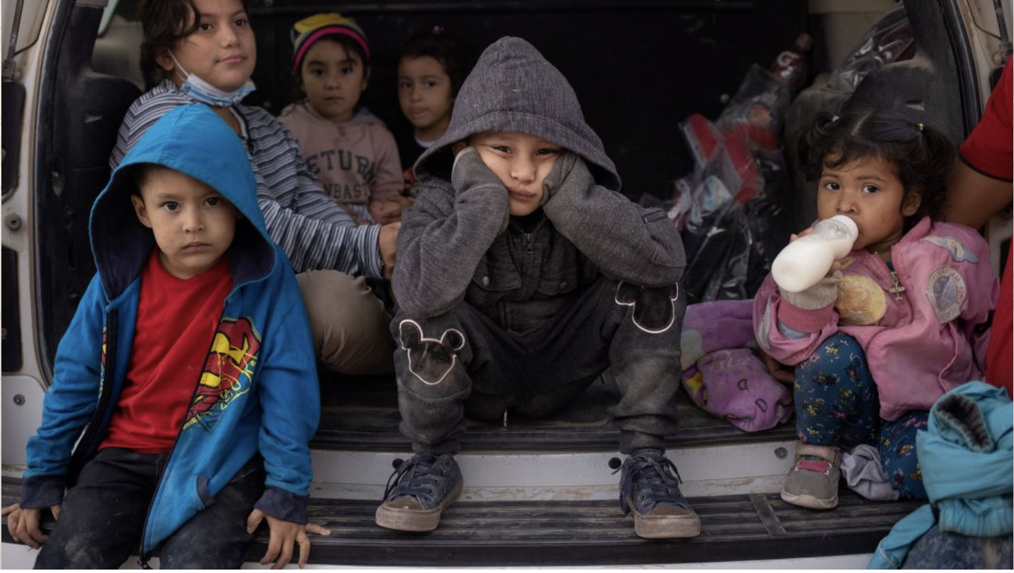
Adrees Latif/Reuters
Notes:
Suzy: Don't say anything. Just count to five in your head.

Slide 2
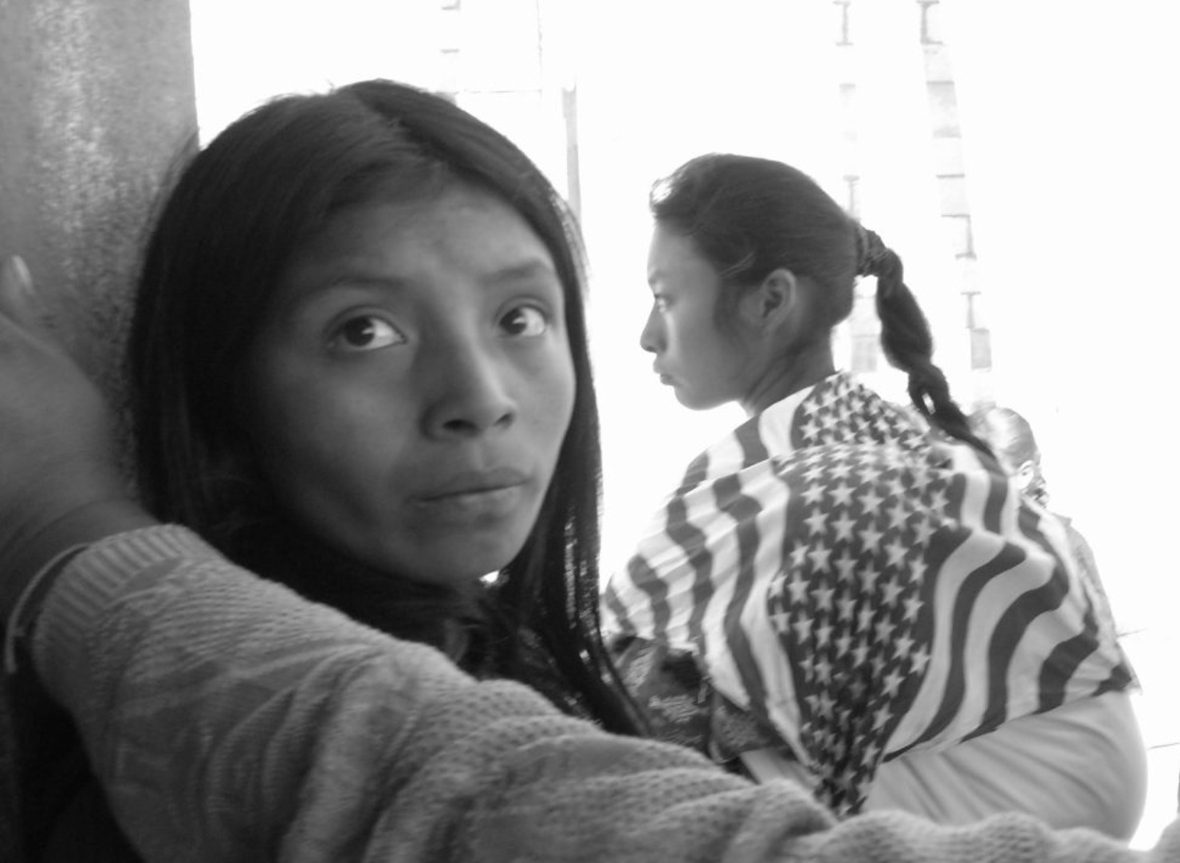
"In El Salvador, they take young girls, rape them and throw them in plastic bags," explains a 15-year-old girl named Maritza.
(https://www.savethechildren.org/us/charity-stories/unaccompanied-minors-border-crisis).
Photo by Emily Yates-Doerr
Notes:
Christina: Read the quote, "In El Salvador, they take young girls, rape them and throw them in plastic bags," explains a 15-year-old girl named Maritza.
Then count to five in your head.

Slide 3
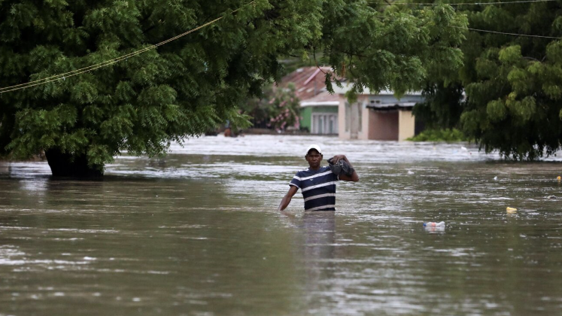
Families who were already struggling throughout much of 2020 due to COVID-19 were then faced with the devastating loss of their belongings, houses, and crops as a result of the hurricanes.
(savethechildren.org) Photo from Reuters
Notes:
Suzy: Read the quote, Families who were already struggling throughout much of 2020 due to COVID-19 were then faced with the devastating loss of their belongings, houses, and crops as a result of the hurricanes.
Then count to five in your head.

Slide 4
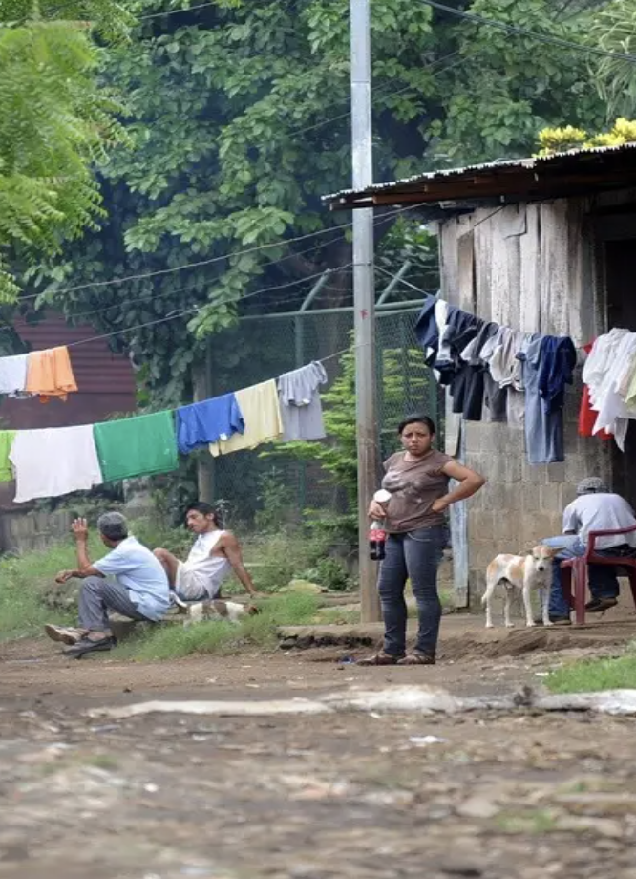
“The increase in poverty [in Latin America] will make it very hard for the most vulnerable children and their families to make up for the loss,” said Janti Soeripto, CEO of Save the Children
(SavetheChildren.org)
Photo by Elmer Martinez
Notes:
Christina: Read the quote: “The increase in poverty [in Latin America] will make it very hard for the most vulnerable children and their families to make up for the loss,” said Janti Soeripto, CEO of Save the Children
Then count to 5 in your head.

Slide 5
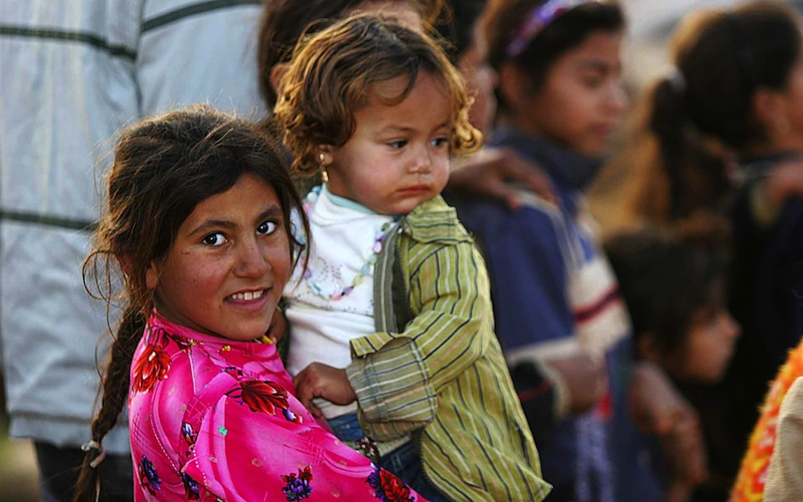
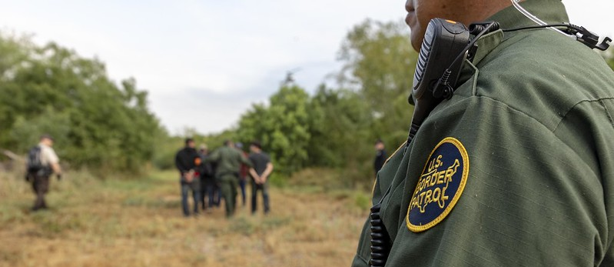


Encountering Unaccompanied Minors at the U.S. Southern Border
Christina Chavez, Princess Ekezie, Suzy Jones
In fulfillment of DSO110
Final Group project requirements
This Photo by Unknown author is licensed under CC BY-ND.
This Photo by Unknown author is licensed under CC BY.
Notes:
Suzy: Our presentation is titled: Encountering Unaccompanied Minors at the US Southern Border

Slide 6

Agenda
Introductions
The Dataset and its Importance
Analysis of Data
Demographics
Encounters over Time
Encounter Type
Correlation/Confusion Matrix
Conclusions
Summary
Learn More
Q & A
Works Cited
Notes:
Christina: The agenda is as follows:
Introductions
The Dataset and its Importance
Analysis of Data:
Demographics of Encounters
Timing of the Encounters over Time
Encounter Types
Correlation Table / Confusion Matrix
Conclusions
Summary
Learn more
Q & A
Works Cited

Slide 7



Introducing The Unaccompanied Adults:
Katie Barry
Christina Chavez is a mother, wife of a retired Army service member, and self-employed project manager with higher education and NPO experience. Her most recent role led migrant service teams in applying for/bidding on federal, state, and local grants/contracts funding services for this and other immigration demographics. The vulnerability of those attempting to immigrate to the U.S., especially those identifying as unaccompanied minors is a "hot, political" topic within the US migrant services sector. As the grandchild of an immigrant deported three times before obtaining US citizenship, she yearns to be part of the functioning solution to this problem.
As a neuroscience major with a minor in politics, Princess possess a unique blend of academic knowledge and practical experience in assisting immigrant families through the citizenship process. Princess is deeply passionate about advocating for unaccompanied minors and aspire to work for the government in order to aid them on their path to becoming citizens. With a foundation in neuroscience and a commitment to social justice, Princess is determined to contribute to the well-being and empowerment of these young individuals as they navigate their journey towards a brighter future.
Suzy Jones is a data scientist with a strong academic background in education, specializing in understanding the complexities of unaccompanied minors crossing the border. For the past decade, as an English as a second language teacher, she has developed a deep understanding of the challenges faced by children and families affected by border procedures and policies. Through rigorous analysis and modeling techniques, she has extracted meaningful insights from government data sources for this project. Our research focuses on identifying risk factors and exploring migration trends of all encounters, but especially these vulnerable children. Ms. Jones strives to contribute to policy discussions and advocate for a more compassionate approach.
Notes:
Suzy: We came up with a silly name for our team, "The Unaccompanied Adults," but in all seriousness, we have quite a diverse background!
First up is Christina Chavez, a project manager ready to dive into the tech field. She has worked in nonprofit, higher education, professional development, and small business arenas. Ms. Chavez isn't afraid to try on different hats. "Offering herself as tribute" for assignments has led to contracts with culturally diverse organizations overseas, entrepreneurs, and other small businesses. Theses opportunities have sharpened her skillset within the US migrant services sector. As the grandchild of an immigrant who was deported three times before obtaining US citizenship, she yearns to be part of the functioning solution to the immigration challenges at the border.
Christina: Princess Ekezie is a Georgia State University Neuroscience major with a minor in Politics. She holds a unique blend of academic knowledge and practical experience in assisting immigrant families through the citizenship process. Princess is deeply passionate about advocating for unaccompanied minors and aspires to work for the government to aid immigrants on their path to becoming US citizens. She contributed to the analysis of our dataset.
Christina: Last, but certainly not least is Suzy Jones; a data scientist with an academic background in education; who specializes in understanding the complexities of unaccompanied minors crossing the border. With a decade of experience as an English as a Second Language instructor, she has witnessed the trauma endured by these children and families firsthand. Through rigorous analysis of government data, her research identifies risk factors and migration trends, especially for vulnerable children. Ms. Jones aims to advocate for a more compassionate approach in policy discussions.

Slide 8

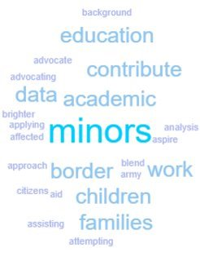



Our "powers" combined assisted us in determining our topic of choice, which hit close to our hearts...
Notes:
Suzy: We have similar experiences and backgrounds that lead to our passion for this final project. We have chosen this topic because subject matter is highly politicized, and the population, very vulnerable.
It is of the most utmost importance we understand the trends of migration in order to protect these children.

Slide 9

The Dataset and its Importance
US Customs and Border Protection page titled, “Southwest Land Border Encounters”
Provides data on:
U.S. BP Title 8 apprehensions
OFO Title 8 inadmissibles,
and Title 42 expulsions
Notes:
Christina: To demonstrate the proficiency of our data science skills we have learned through the Data Science Program, we utilized R, Python, Excel, Tableau, and other programs to wrangle, analyze, and present our findings related to datasets from the Inter-University Consortium for Political and Social Research titled, “Addressing the Surge in Unaccompanied Migrant Children,” and data from the US Customs and Border Protection Department titled, “Southwest Land Border Encounters”. The Southwest Land Border Encounters page provides data on U.S. Border Patrol Title 8 apprehensions, Office of Field Operations Title 8 inadmissibles, and Title 42 expulsions along the southwest land border of the United States. Our end goal is to visually present one aspect of the story concerning migrant unaccompanied minors and to project possible surges.

Slide 10
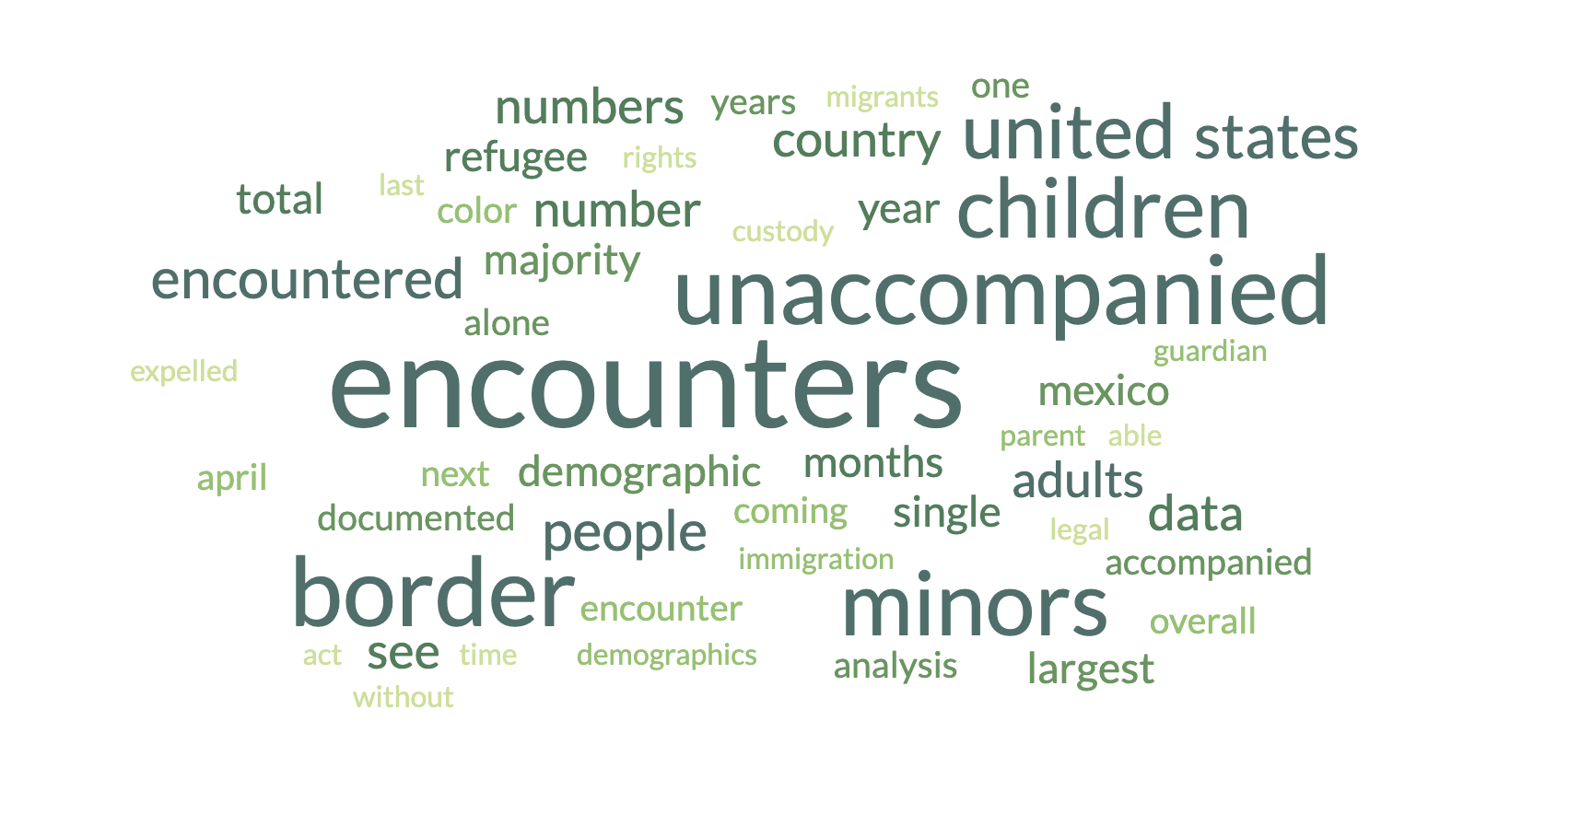
These Numbers Matter!
Notes:
Suzy: This situation demands urgent attention due to a significant increase in border encounters over the last four years. Approximately 6 million people have fleed their countries for various reasons: such as violent abuse, climate-induced conditions, and generational poverty. Among these encounters, around 413,695 were unaccompanied children, equivalent to the size of a city like Minneapolis, MN, Bakersfield, CA, or Tampa, FL.
It's important to note that this analysis doesn't even account for unaccompanied minors who were NOT documented during the border encounters of this dataset.
The current practices at the border are both unethical and unconstitutional, contradicting the principles laid out in the Immigration and Nationality Act, the Migration and Refugee Assistance Act of 1962, and the Refugee Act of 1980, which were established to protect refugees and individuals fleeing persecution. Additionally, these practices violate the Universal Declaration of Human Rights, primarily written by Eleanor Roosevelt, which was put in place after the atrocities of WWII and the Holocaust.
To address this situation, the United States must urgently redesign its policies and procedures for individuals from Latin America seeking asylum and refuge.

Slide 11
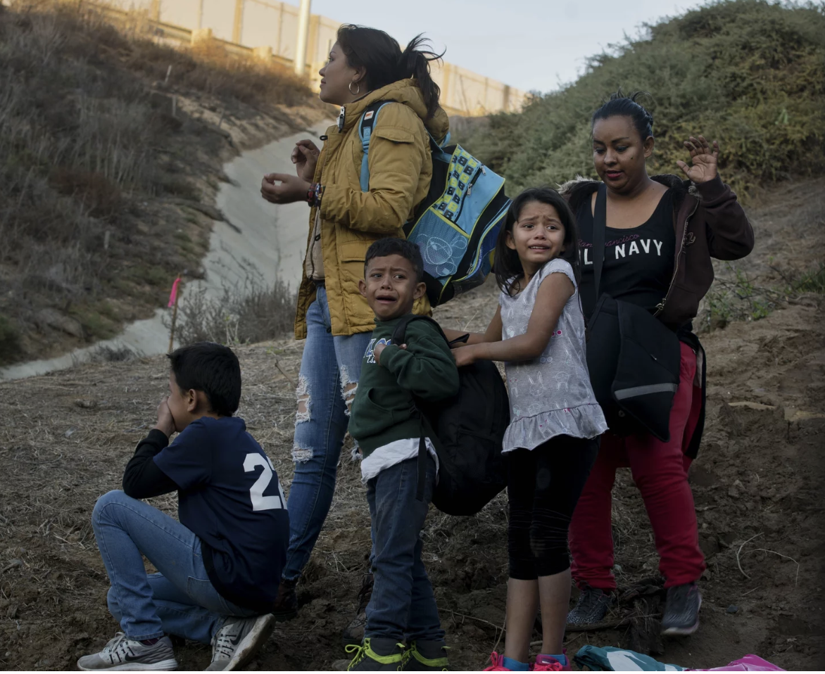
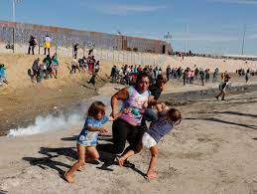
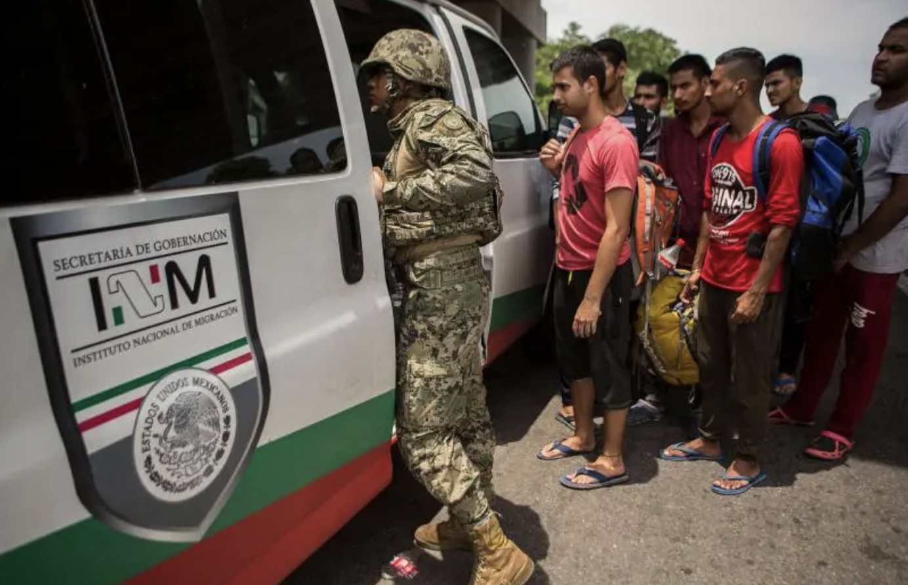
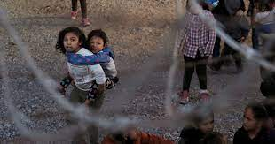

Defining Demographics:
Oliver de Ros
Ramon Espinosa, AP
Kim Kyung-Hoon, Reuters
Photo by Lucas Jackson, Reuters
Single Adults
One adult over the age of 18
FMUA
Individuals in a Family Unit
Accompanied Minors:
Children arriving in the US with a parent or guardian
UC/Single Minors:
No lawful immigration status in the US
<18 years of age
No parent/legal guardian in US or no parent/legal guardian in US available to provide care and physical custody
Notes:
We will be exploring different demographics or groups of people crossing the border.
Here is how the government defines those groups:
-Single Adults: Identified as ONE adult over the age of 18
-FMUA: Individuals in a Family Unit
-Accompanied Minors: The immigration laws do not define the term “accompanied” children, but children arriving in the United States with a parent or guardian are considered accompanied minors
-UC/Single Minors: By definition, an unaccompanied child (UC):
Ø Has no lawful immigration status in the United States
Ø Is under 18 years of age
Ø Has no parent or legal guardian in the United States or no parent or legal guardian in the United States is available to provide care and physical custody
This analysis will look at all demographics, with a special emphasis and focus on Unaccompanied Minors in comparison to the total population where appropriate.

Slide 12
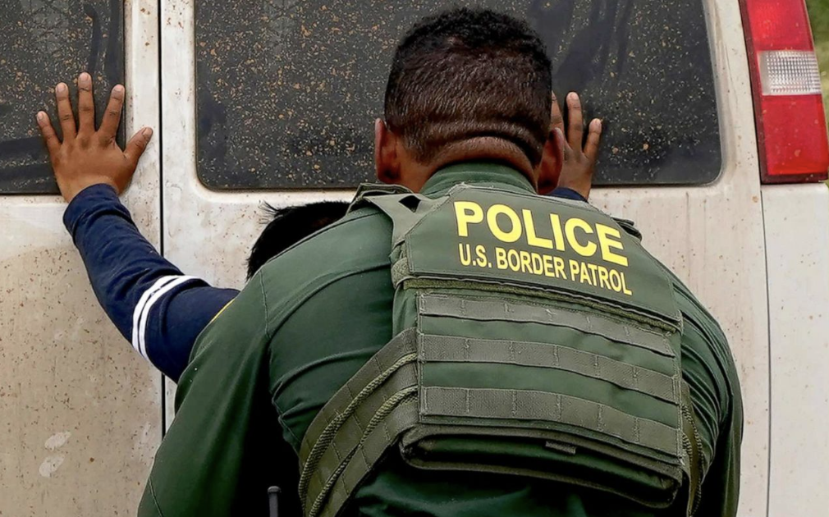
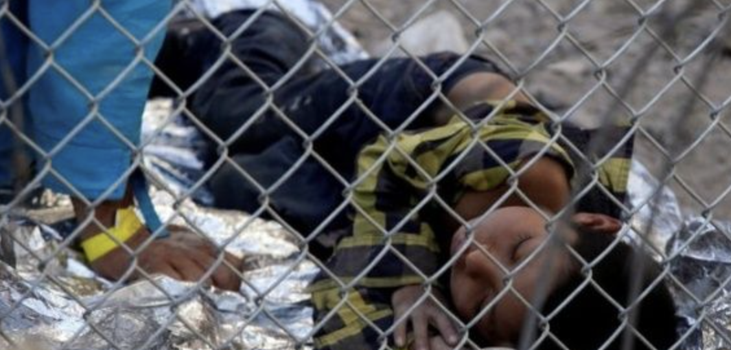
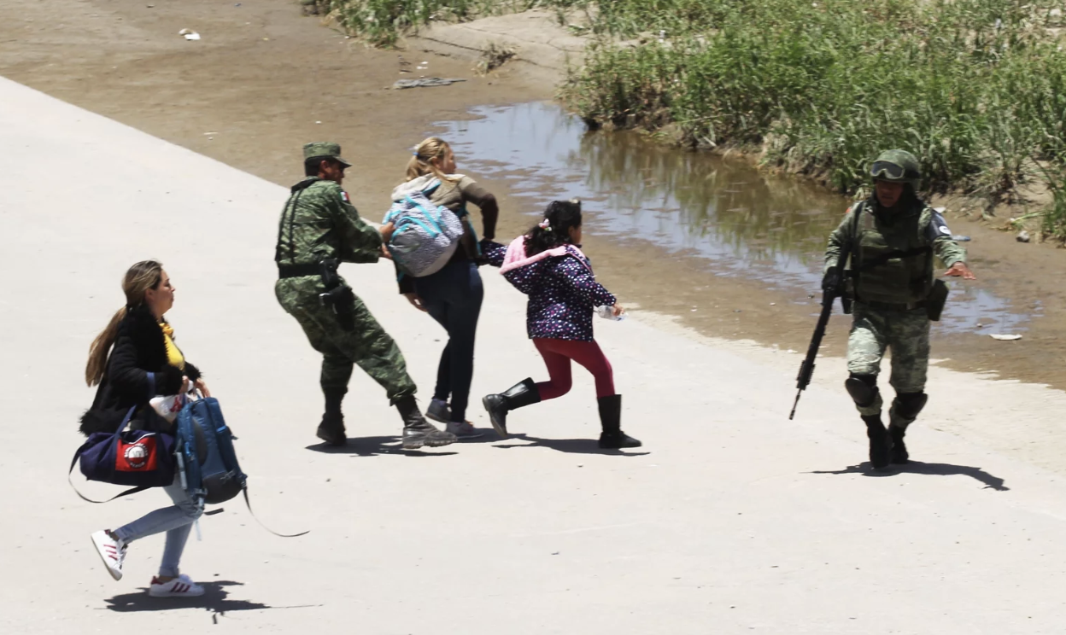
Defining Types of Encounters:
Apprehensions: migrants are taken into custody in the United States – at least temporarily
Expulsions: migrants are immediately expelled to their home country or last country of transit
Inadmissible: migrants are not able to be lawfully let into the country
Reuters
Matt York/AP
Herika Martinez/AFP/Getty Images
Notes:
Christina: Defining Encounter Types:
Apprehensions: migrants are taken into custody in the United States – at least temporarily – to await adjudication (legal ruling or judgement)
Expulsions: migrants are immediately expelled to their home country or last country of transit without being held in U.S. custody
Inadmissible: migrants are not able to be lawfully let into the country because of health, criminal activity, national security, public charge, lack of labor certification (if required), fraud and misrepresentation, prior removals, unlawful presence in the United States, and several miscellaneous categories.

Slide 13
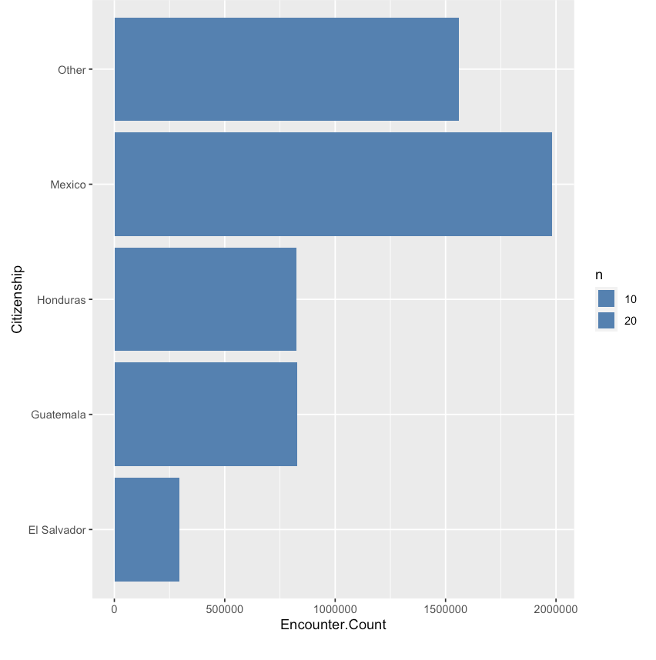
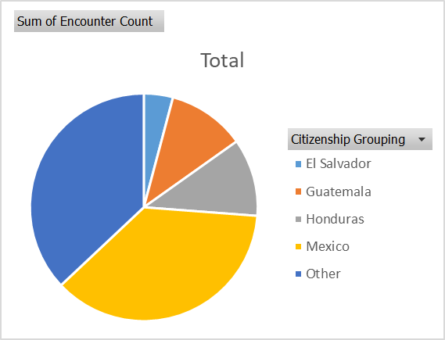
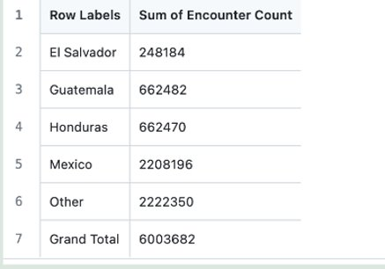
Where People are Coming from...
Notes:
Suzy: Consulting the U.S. Customs and Border Protection data from 2020 to April of 2023, we now see the majority of encounters are from Mexico. They’ve had a total of 2,208,196 people met at the US border. That is more than the encounters of Honduras and Guatemala combined. The people encountered are looking for safety, housing, and work…Many coming from southern Mexico.

Slide 14
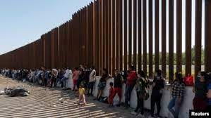
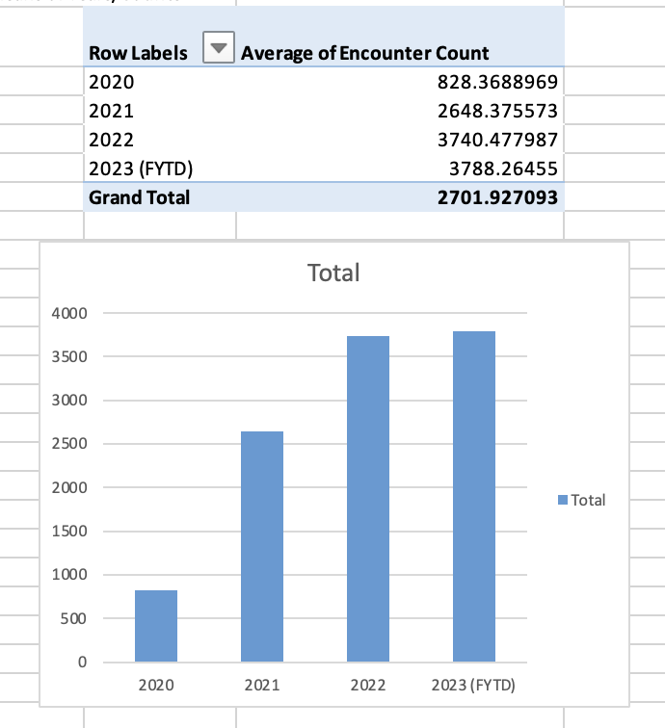
Time in Relation to Encounters at the Border:
Significant increase after 2020
Coronavirus forced borders to be closed in April 2020 which slowed migration (Pew Research)
Continued increase through 2023
Total averages per year: 2,702
Notes:
Christina: Let's look at the encounters over the last four years. These are all demographics combined for a total average. We can see the averages of encounters increased immensely after 2020. It is not that the situations got worse, but the closing of the border in April 2020 due to the coronavirus. It was even more difficult during this time to cross the border. Remember this is the average. If we look at all four years, the average of all the years is 2,201 people.
There are several events that correlate with the increase, including the election of Joe Biden (anticipating border policy changes) and the decrease of COVID-19 cases for example.

Slide 15
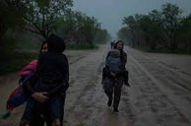
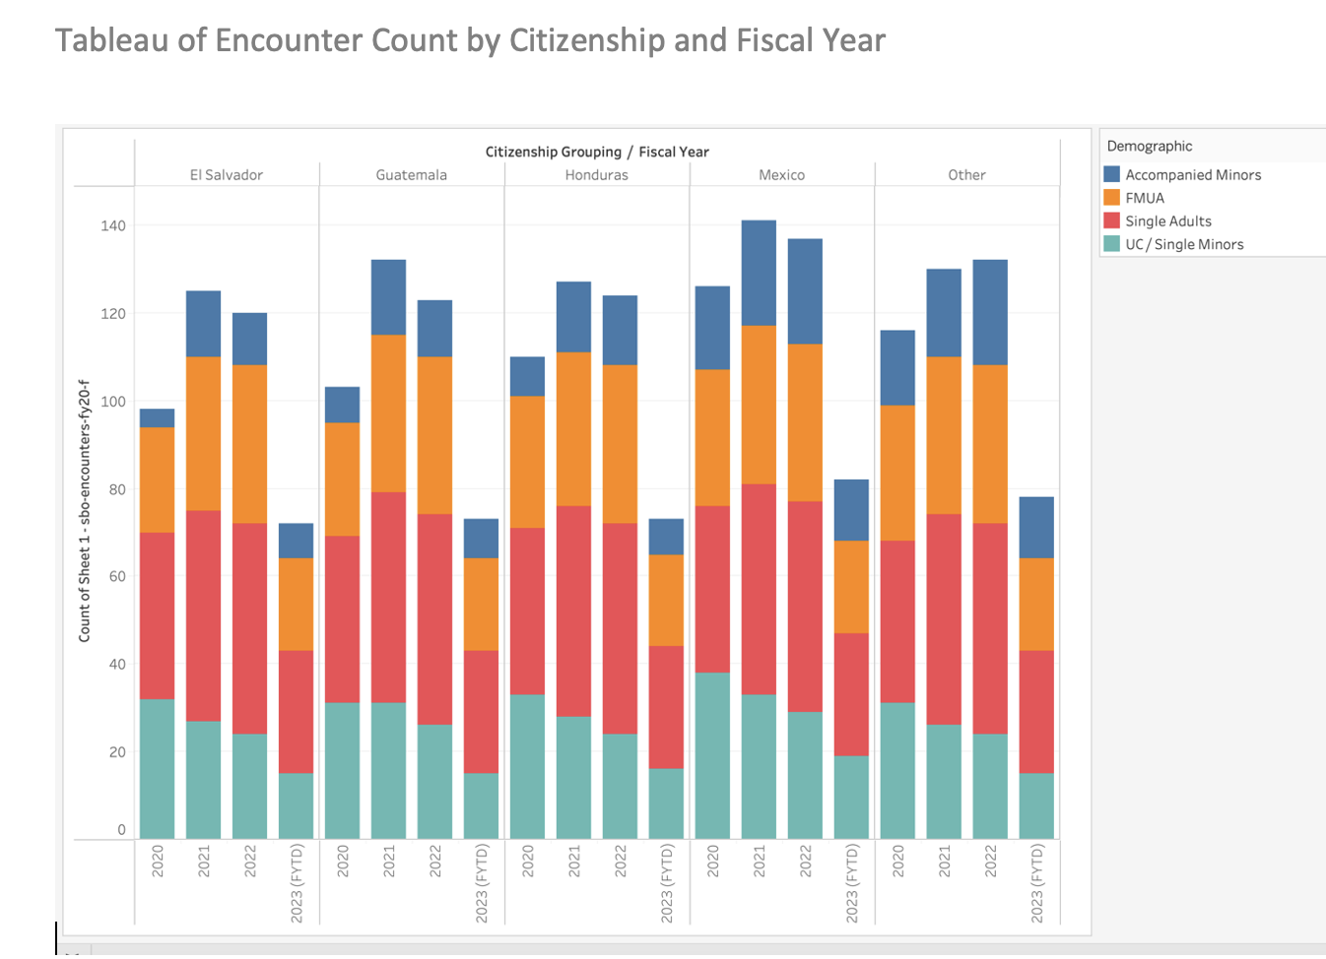
Who Came from Where and When?
2021 & 2022 encounters higher
2023 fiscal year has not ended yet
Demographics mirror totals
NOT UC/Single Minors
Fewer UC/Single Minors encountered at border over last 4 years
Not necessarily a good thing
Notes:
Suzy: Overall, the number of encounters from each country included in the dataset, were significantly high in 2021 and 2022. This is after the world shut down due to covid and then began to open bit by bit. 2023 is overall less than average because the fiscal year has not ended yet.
The demographics seem to mirror the combined encounter numbers except for the unaccompanied minors. We see them highlighted in a turquoise color at the bottom of the graph. If we follow the trends of the unaccompanied minors, in 2020, we had singular children being encountered at the southern US border, than in 2021 or 2022.
Over the last four years, the number of unaccompanied minors has decreased. That could mean less are coming alone or more are trying to come into the country without using the entrance points, which increases the risk and danger of an already perilous journey.

Slide 16
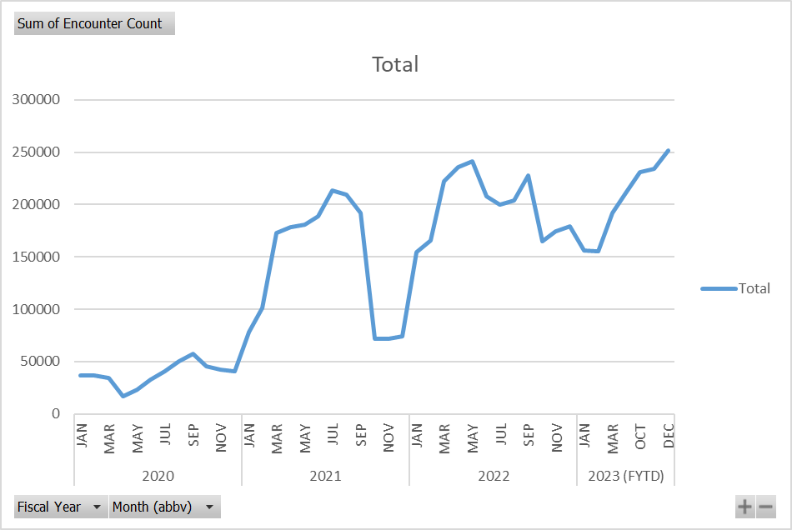
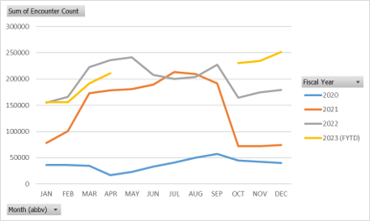
Total Encounters over Time & Total Encounters Comparison by Year
Notes:
Christina: Here, we have the total of ALL encounters over time from January 2020 through April 2023. We can see that there are peaks and various dips in encounter counts, although overall encounters have increase since 2020. Ideally, we would like to see more history prior to 2020, since COVID-19 impacted the encounter numbers in comparison to the following years to date. This doesn't mean that people were not coming, but they were not allowed to "be" encountered.
By comparing Total Encounters by Year, we can see trending increases and decreases over the course of the year, month-to-month. With the exception of 2020, year 2021, 2022, and 2023 to date have similar trend lines over the months, generally increasing encounter counts every year.

Slide 17
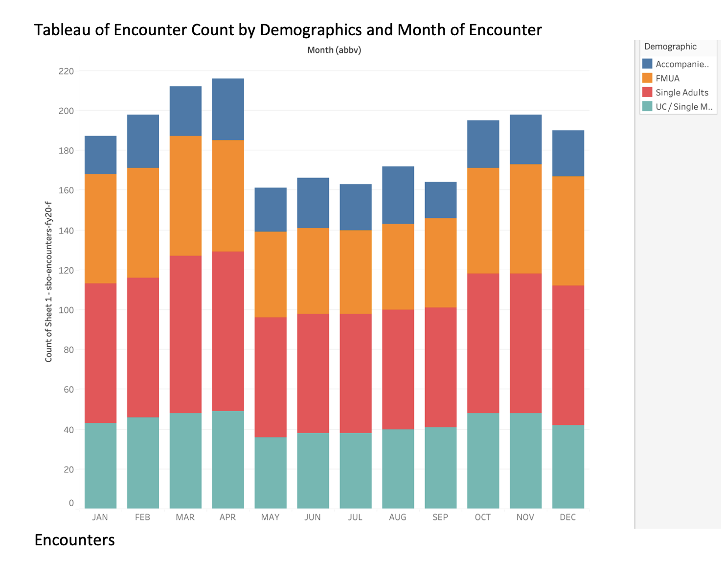
Months of Encounters
Most encounters occur in fall and winter months
In summer months, it is too hot / wet
UC/Single Minors data aligns with general demographic trends.
Notes:
Suzy: Looking at encounters for each month throughout the four-year span of the dataset, months of travel are highest in January, February, March, and April. Then drastically drop off in May, June, July, and August. The number of encounters increases again come September, October, November, and December. This aligns with the weather. The May, June, July, August months are very hot and very rainy not only in Texas where they are crossing into the US, but in Mexico where migrants had to pass through. The encounters of unaccompanied minors reflects the trend as a whole. Kids are waiting for the dryer and cooler months to travel when it is the safest.

Slide 18
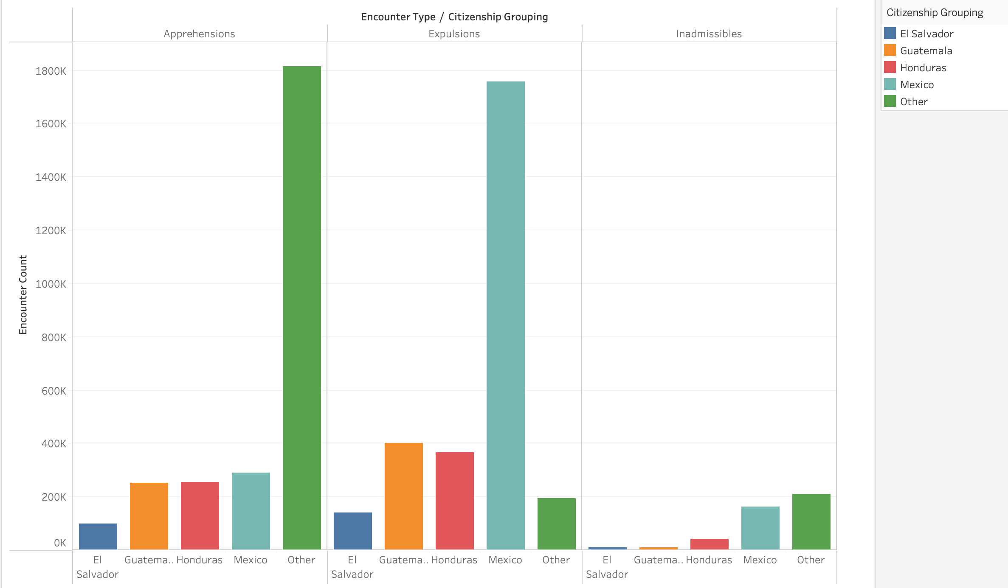
Encounter Type by Citizenship
Notes:
Christina: This figure provides us with information regarding Encounter Type by Citizenship.
Let's revisit the Encounter Types. What can happen to immigrants once encountered:
They can be taken into custody in the United States to await adjudication: Apprehension. Those encounters with country of citizenship classified as "Others" had the highest number of Apprehension... over 1,800,000 since Jan 2020
They can be sent back to their country of citizenship or last country of transit: Expulsion. The most number of expulsions occurred to immigrants from Mexico (over 1,700,000 since January 2020)
Or they're not able to be lawfully let into the country due to a number of reasons: Inadmissible. This category has the least number overall.
What this graph does not tell us is the status after apprehension... let's say for example... what happens after a single adult was apprehended, processed, but then expelled for whatever reason.

Slide 19
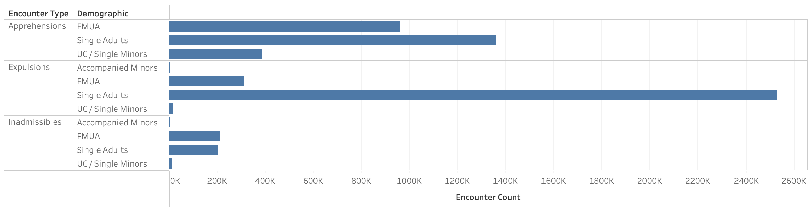
Demographics and Encounter Type
Notes:
Suzy: Here, we have a figure depicting Demographic Counts by Encounter Type.
Note that Accompanied Minors (children with an adult or family member) were not apprehended at all during the four year span of the data set. Those Encounters deemed "Inadmissible" have much lower numbers in comparison to the other two Encounter Types overall. Some unaccompanied minors were expelled. Ask yourself what happens to UCs that are expelled?
The highest number of Apprehensions and expulsions are Single Adults. The term Single Adults encompasses men and women between the ages of 18 and 100. That is a very wide spectrum. We know from our research from PBS News Hour, many women who travel alone are assaulted on the way to the border, adding one more dimension to this already traumatic experience. What else happens to these people when they are apprehended or expelled? This is one of many points where we wish we had more time to dive into that demographic with another data set if we could find it.

Slide 20
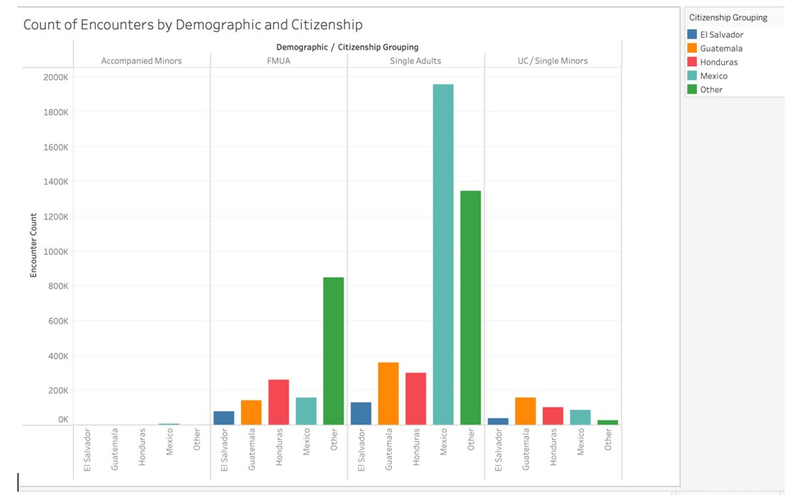
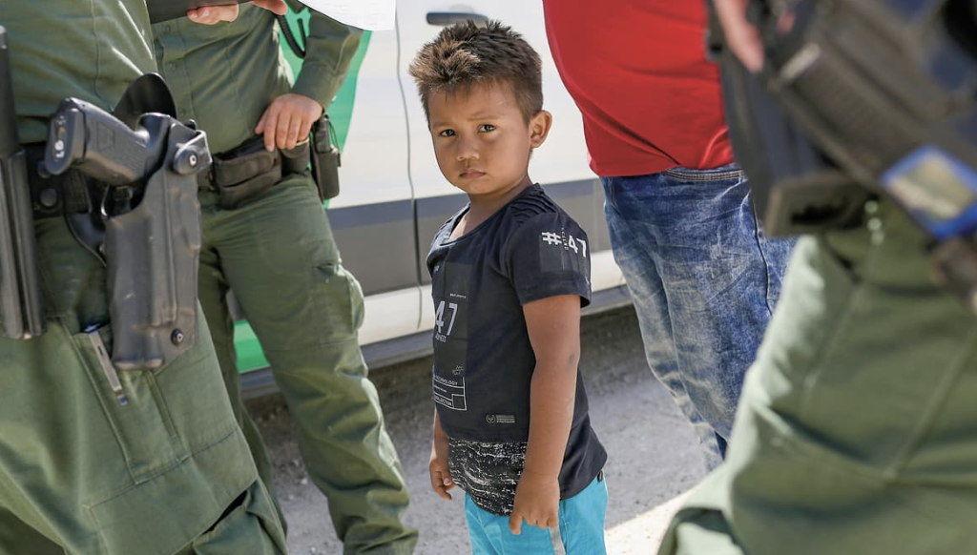
Encounters by Demographics and Citizenship
Photo by Upfront, NYT
Notes:
Christina: This graph combines the data from the previous two graphs, and provides us with the Count of Encounters by Demographic and Citizenship.
Remember, these are total numbers from January 2020 to April 2023
The demographic with the largest numbers overall were identified as "Single Adults," the majority from Mexico,
The next largest demographic were "Individuals in a Family Unit," with the majority coming from "Other" countries of origin.
Unaccompanied Children follow as the next largest demographic, with the majority arriving from Guatemala.
Accompanied Minors have the least total numbers, although the majority arrived from Mexico.

Slide 21
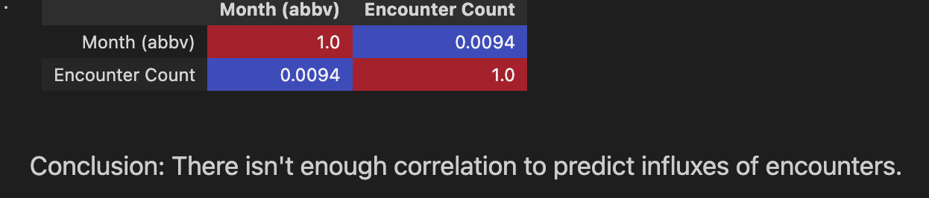
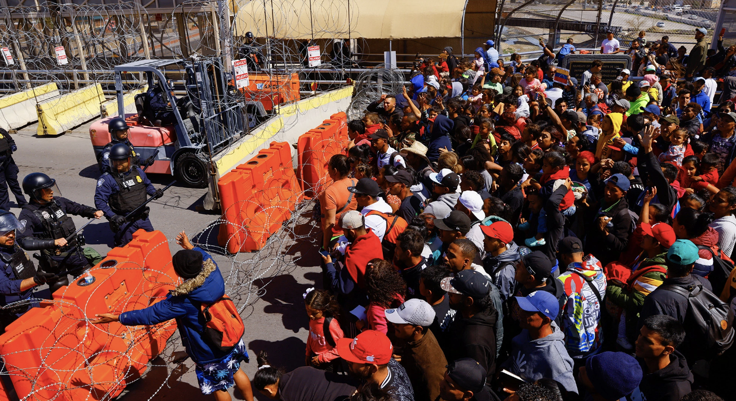
Can we predict when the next influx of encounters will be?
Photo by Reuters
No, there isn't enough correlation to predict influxes of encounters
Notes:
Suzy:
This is our Correlation or Confusion Matrix. If you look at the colors, they are opposite. Red is a warm color and blue is a cool color. They represent two pieces of data we are comparing, months and how many encounters there were at the border, and are not connected enough to predict any trends or future influxes of people. If we were seeing a red and an orange or yellow, we might be able to make prediction of which month we see more encounters at the border.
Because we do not see any variance of color other than red and blue, and there is no linear correlation between these two variables, we cannot determine when the next influx will occur.

Slide 22
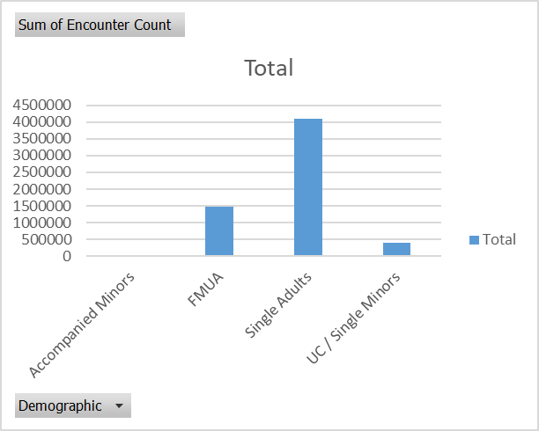
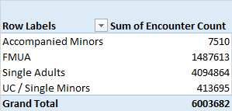
Conclusions
Latin Americans leaving their home country due to:
impending violence,
effects of climate change,
generational poverty
Over 6 Million Encounters
Roughly 7% are UCs
Encounters by Country:
Guatemala 11% (UC: 38%)
Mexico 37% (UC: 21%)
Honduras 11% (UC: 24%)
El Salvador 37% (UC: 10%)
"Others" 4% (UC: 7%)
Notes:
Christina: Our Conclusions... Based on our research and analysis:
Latin Americans leaving their home countries due to impending violence, the effects of climate change and generational poverty.
. Over 6 million have been encountered.
. 6.9% of those encountered are unaccompanied children (the bar is barely visible on the left side of the bar graph.)
. Although the percentage is small, 413,695 children are still SIGNIFICANT. Imagine the population of Tampa, Florida consisting of nothing but children. That is how many Unaccompanied Children have been encountered at the border. If this is the number of encounters documented, what about those that were not encountered?
The percentages under Encounters by Country detail first the overall percentage of citizenship, and then the percentage of only Unaccompanied Children encountered.
. The largest numbers of Encounters came from El Salvador, but the largest numbers of Unaccompanied Children arrived from Guatemala
. We concluded that we cannot determine when then next influx of encounters will occur.

Slide 23
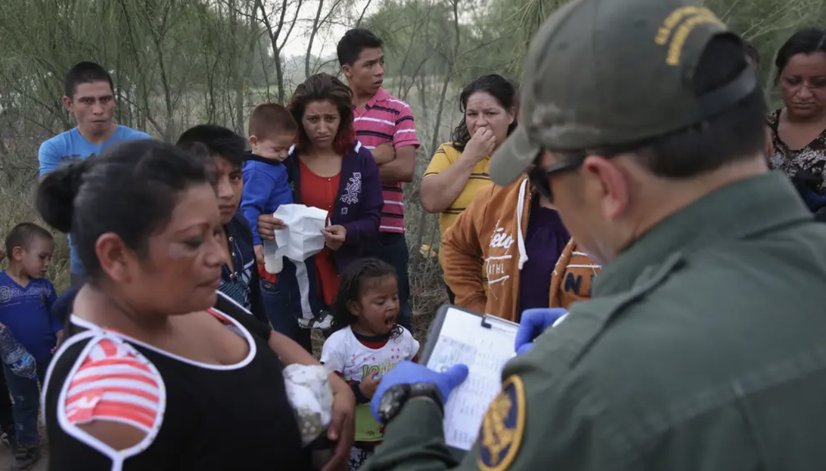
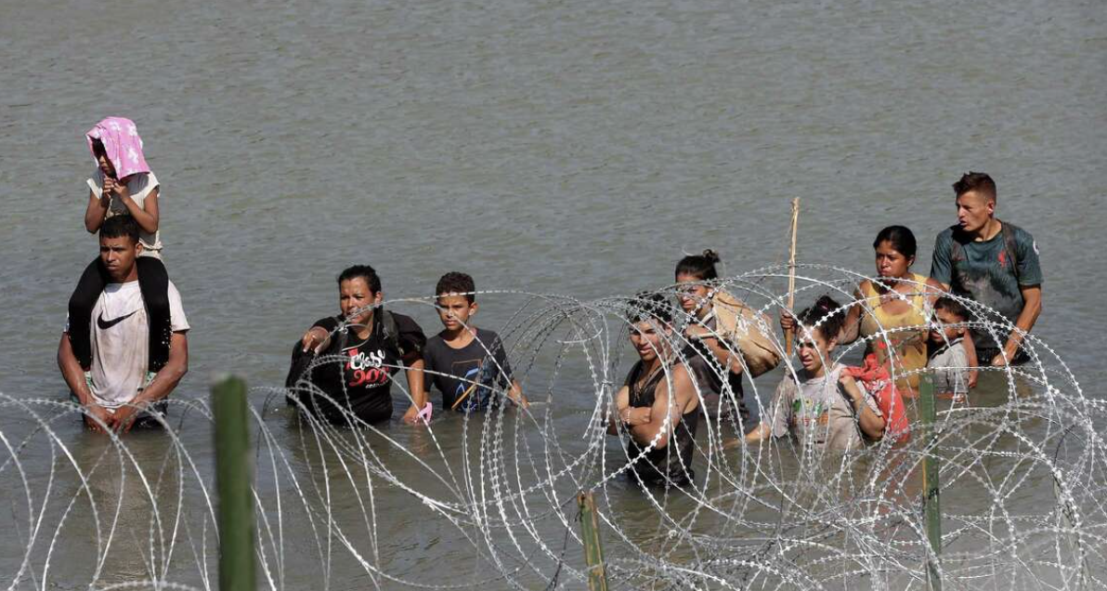
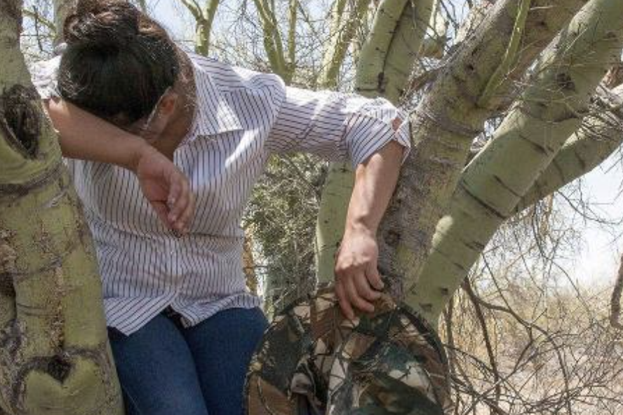
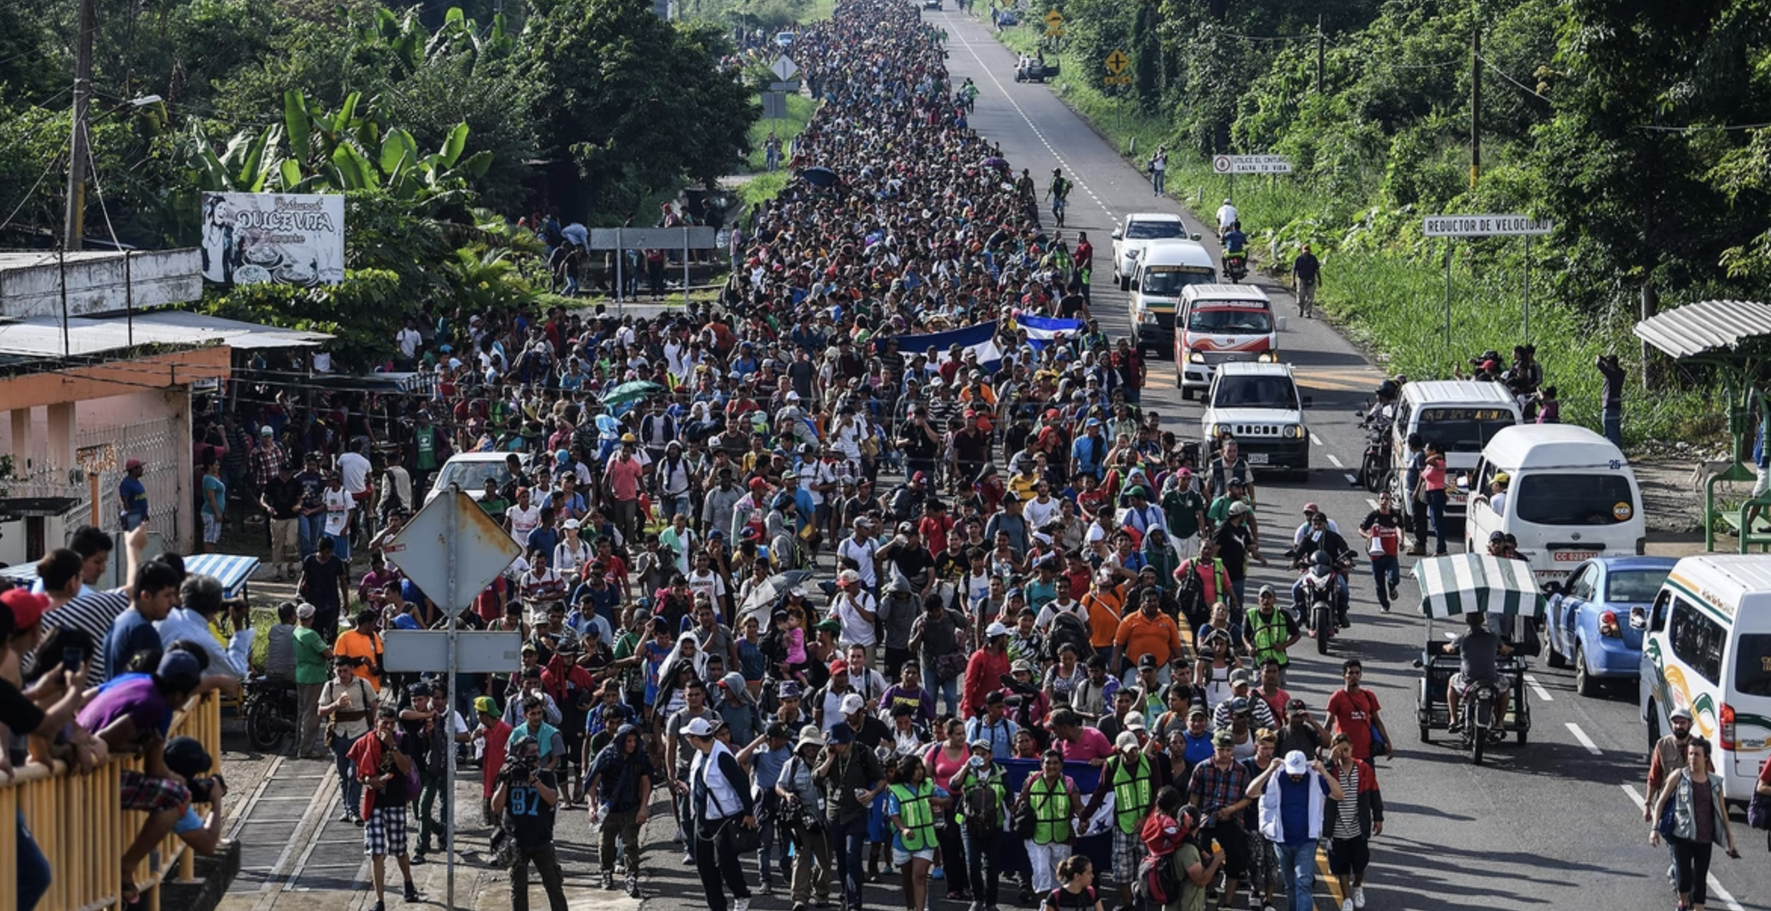
Summary...
John Moore/Getty Images
The Dataset and its Importance
Analysis of Data
Conclusions
Photo by San Antonio Express News
Pedro Pardo / AFP / Getty
USA TODAY NEWS
Notes:
Suzy: To review, this presentation was our team's opportunity to demonstrate proficiency and mastery of our newly acquired data science skills obtained through the Data Science Program.
We used Programming Language tools and Analysis Programs such as R, Python, Excel, Tableau, etc., to wrangle, analyze, and present our findings related to the dataset obtained from the U.S. Customs and Border Protection Department.
Although, there was not enough of a correlation or connection between variables to predict future influxes of encounters at the US border,…..... Our end goal was to present a glimpse of the story of migrant unaccompanied minors, and illustrate that story with the numbers.

Slide 24




Learn more....
"Crossing the Border: Firsthand Accounts"
New York Times: Crossing the Border
"El Salvador, Guatemala, and Honduras Situation"
"'There Is Nothing For Us Here': Why People Keep Leaving Guatemala"
"What asylum-seekers meet when they try to cross legally"
Notes:
Suzy: Here are some resources that contributed to the depths of understanding the humanity of this story told through numbers.

Slide 25

Questions from the Audience?
Notes:
Christina: Are there any questions for our team?

Slide 26

Works Cited
U.S. Customs and Border Protection (CBP). 2023, July 13. FY20 - FY23(YTD) Southwest Land Border Encounters (October) . Retrieved from https://www.cbp.gov/document/stats/southwest-land-border-encounters
Bhargava Ray, S. *. 2016, Fall. Applying the U.S. Constitution to Foreign Asylum Seekers: Exposing a Curious, Inconsistent Practice in the Federal Courts. Marquette Law Review. Retrieved from https://scholarship.law.marquette.edu/cgi/viewcontent.cgi?referer=&httpsredir=1&article=5304&context=mulr#:~:text=THE%20FEDERAL%20COURTS,-SHALINI%20BHARGAVA%20RAY&text=Specifically%2C%20they%20rely%20on%20constitutional,as%20political%20opinion%20or%20religion.
American Immigration Council (2023, July 6). https://www.americanimmigrationcouncil.org/
Human Rights Watch. (2022, June 6). Mexico: Asylum Seekers Face Abuses at Southern Border. Retrieved from https://www.hrw.org/news/2022/06/06/mexico-asylum-seekers-face-abuses-southern-border#:~:text=(Los%20Angeles)%20%E2%80%93%20Migrants%20and,Human%20Rights%20Watch%20said%20today.
Notes:
Suzy: Here are the Works Cited

Slide 27

Thank you!
Notes:
Christina: Thank you for your attention and investment in our presentation.
Have a great day! :)

